Slide 1
Small Business Enterprise Program
April 10, 2025

Slide 2

Participation Goal
25%
Award Contracts
Architectural design services, Engineering Design services or construction services - $50,000 or greater to utilize certified small businesses, subcontractors, suppliers and consultants
Race & Gender Neutral
SBEP is a race and gender-neutral program, open to participation without regard to race, color, sex, religion, national or ethnic origin, age or disability.
sbep@fortbendisd.gov

Slide 3
FBISD RECOGNIZED CERTIFICATIONS
CITY OF HOUSTON
SBE
WBE
PDBE
MBE
METRO
SBE
PORT HOUSTON
SBE
US SBA
8A

Slide 4
REGISTER
Vendor Registration - To be eligible as a “Small Business” under the SBEP, a business must adhere to the following criteria:- Visit the Vendor Registration section in Bonfire (https://fortbendisd.bonfirehub.com/portal/)
Sam.Gov - SAM.gov, an official website of the U.S. government. There is no cost to use this site. The unique entity identifier - On April 4, 2022, the unique entity identifier used across the federal government changed from the DUNS Number to the Unique Entity ID (generated by SAM.gov).

Slide 5

FBISD Small Business Enterprise Program Upcoming Events
Virtual One-on-One Meetings
https://www.fortbendisd.com
to request an appointment)
Virtual Information Session
(Visit www.fortbendisd.com
May 28, 2025
2:00 PM – 3:00 PM
Fort Bend ISD
Needs Your Business
June 25, 2025
2:00 – 4:00 PM

Slide 6
Design & Construction

Slide 7

Bond 2023 Design Update
3 - Bond Packages A/E Contracts Issued
Renovations
Intercom
Sitework

Slide 8

BOT AWARDED CONSTRUCTION CONTRACTS
January – March 2025
BP017– Triplex Renovation
BP025 – Transportation Center
BP026 – Miscellaneous Renovations
BP046 – HVAC – MEP West Zone 1

Slide 9


FUTURE CONSTRUCTION CONTRACT BOARD ITEMS
May 2025 Board Cycle
BP039 – HVAC – MEP East Zone 1
June 2025 Board Cycle
BP031 – Bush HS Renovations

Slide 10
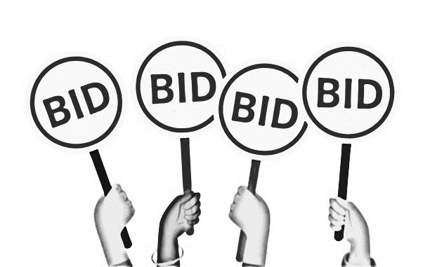

Bond 2023 Bid Schedule
BP032 – Hightower HS Renovation
Pre-Construction Meeting – May 8
Bid Opening May 27
Anticipated Board Approval – August 2025

Slide 11
FBISD FACILITIES & MAINTENANCE

Slide 12
Terrence Thomas, Director
Mark Flynn, Manager
FBISD Facilities & Maintenance

Slide 13
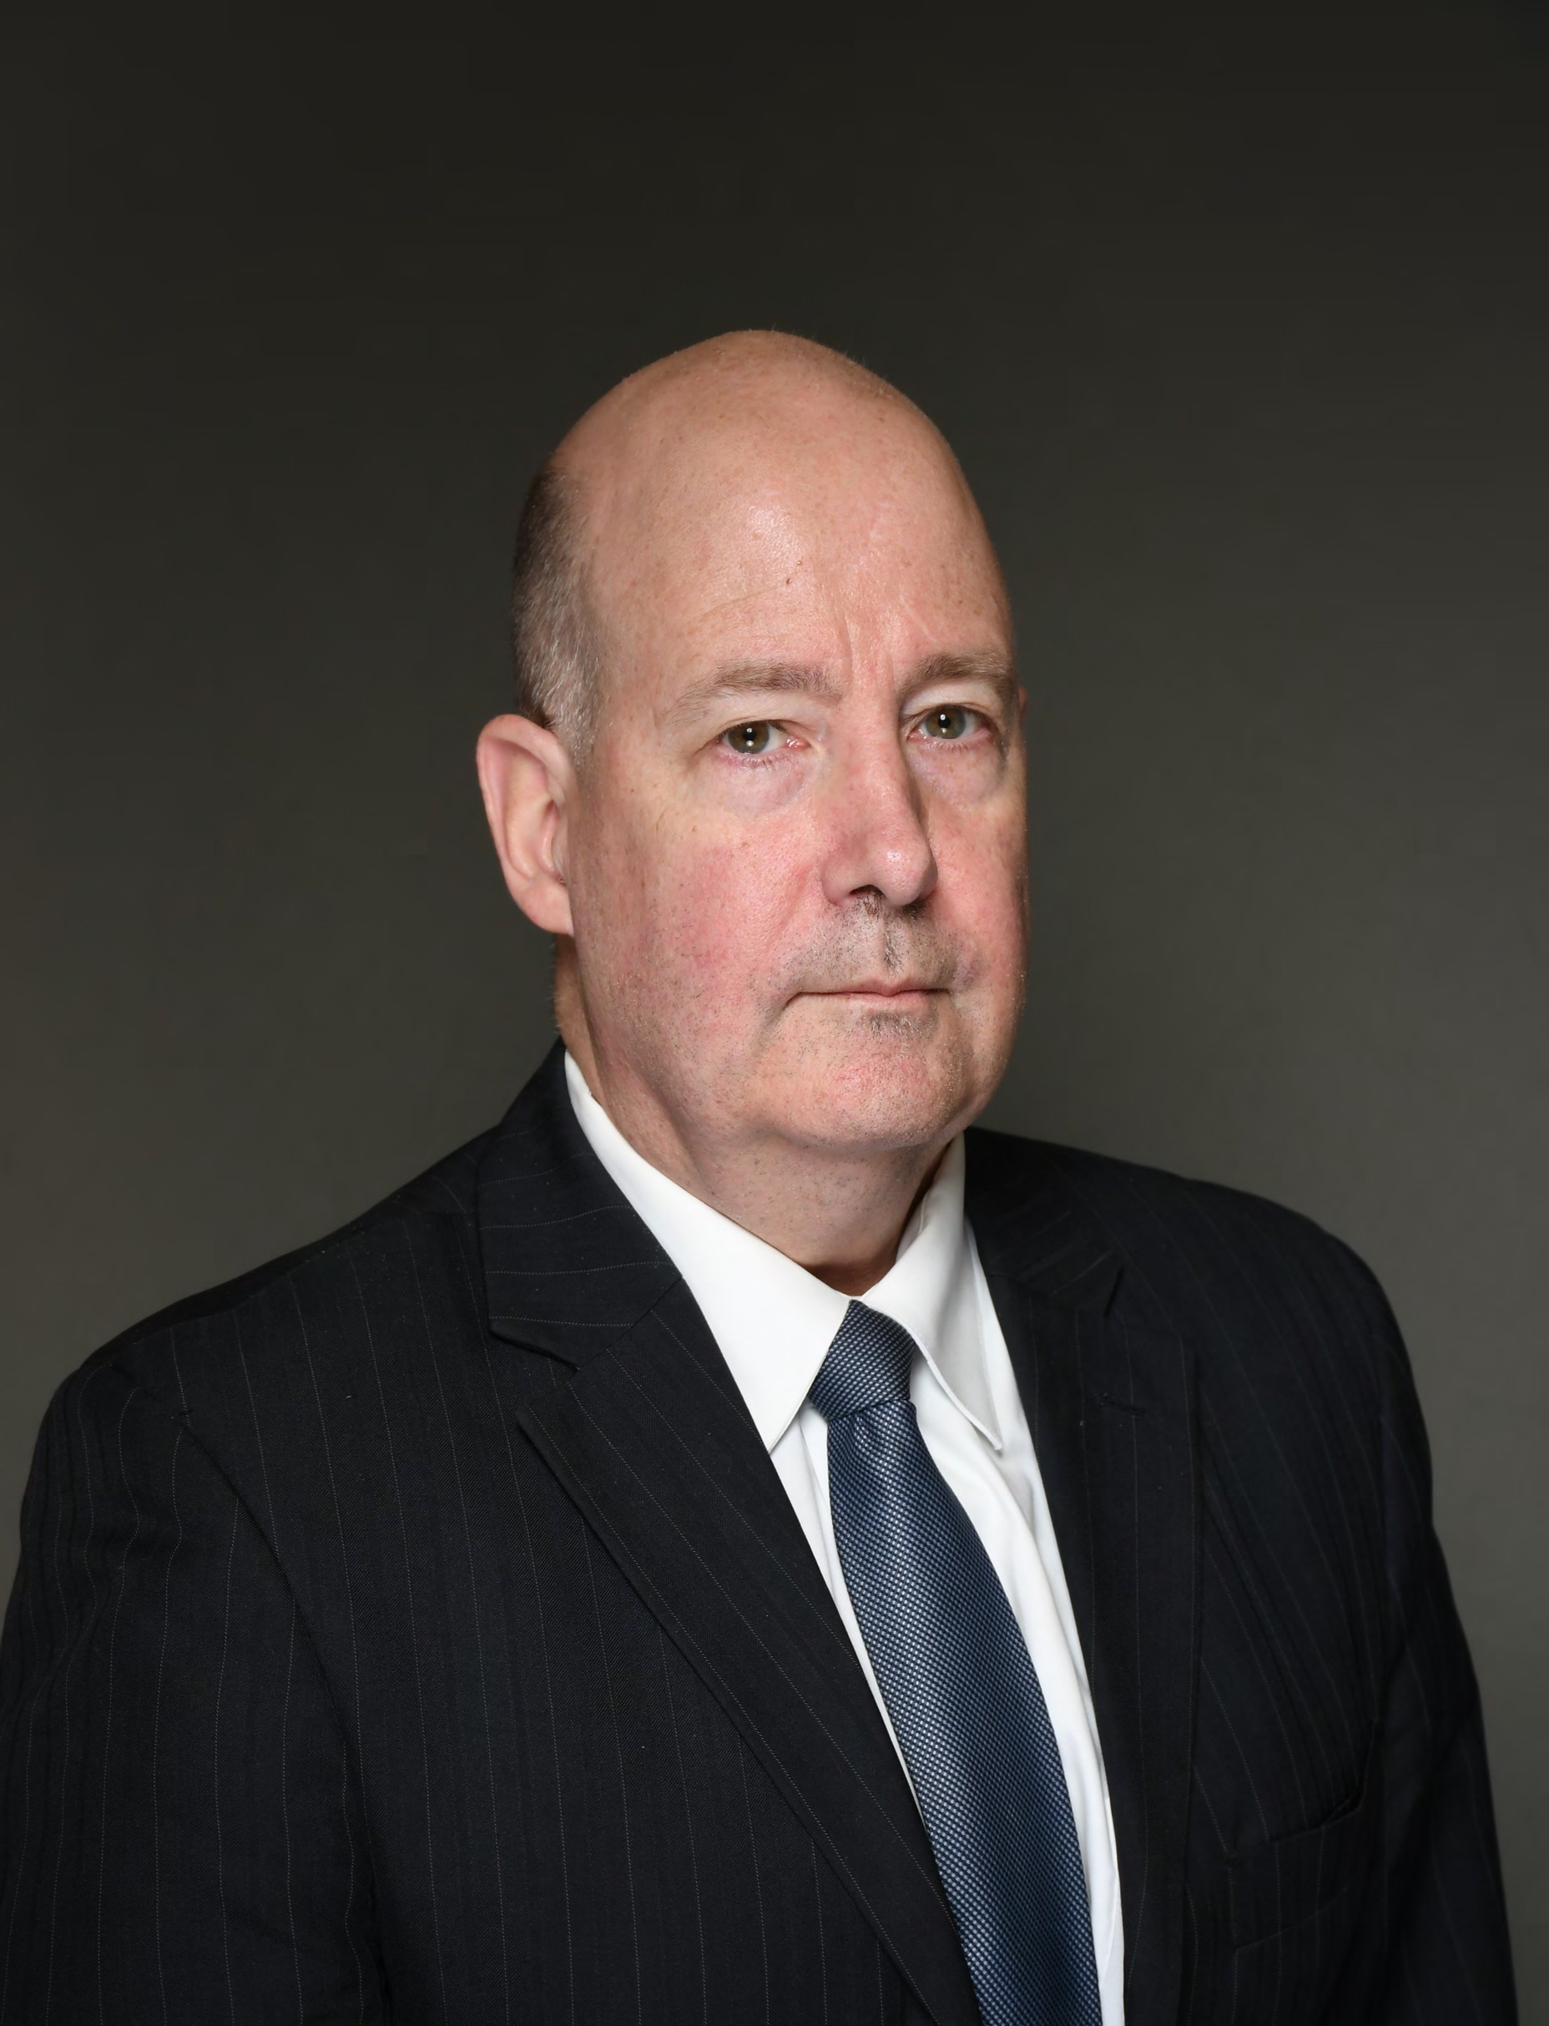


Mark Winchester, Deputy District Director-US SBA
Regent Stephanie D. Nellons-Paige
Notes:
Regent Stephanie D. Nellons-Paige was appointed to the Texas Southern University (TSU) Board of Regents by Texas Governor Greg Abbott in October of 2020. A lifelong servant leader and philanthropist, her career has spanned the public and private sectors and focused on improving outcomes for cities through infrastructure building and partnership development. Regent Nellons-Paige has more than 30 years of senior executive experience leading business and strategic partnership development with Fortune 500 companies in public transportation, fleet and facilities maintenance and food services management. She is adept at working with diverse constituencies and exhibits refined and transformative leadership that moves the pendulum toward success on complex projects.
She is the Chief Executive Officer and Board Vice Chair of the Nellons Paige Group, Inc. (NPG), a strategic consulting firm, which she co-founded with her husband, Rod Paige, U.S. Secretary of Education (2001-2005). The firm provides business development expertise to the private sector, infrastructure investment entities, foundations, school districts and higher education institutions and cities, and also advises clients on diversity and economic inclusion. NPG has helped clients in the transportation, food service and facilities maintenance industries generate nearly $1 billion in revenue and residuals.

Slide 14
FBISD PURCHASING
Doing Business With FBISD Overview

Slide 15
PURCHASING PROCESS – WHY WE BID
The District makes purchases within relevant statutes and policies: State Statute requirements are primarily found in the Texas Education Code 44.031​, Texas Government Code 2254 and 2269
District policies related to purchasing (CH (Local) & CH (Legal) Purchasing and Acquisition district policies can be accessed through the District website. ​
Individual campuses and departments are not separate legal entities​
​
When determining what sort of competitive process will be required for the purchase of goods or services, the entire District's purchases are considered by the aggregate​
​
While working within these statutes and policies, the District’s objective is to purchase the best products, materials, and services considered the Overall Best Value.​
Cooperative Purchasing Agreements and/or Central Texas Purchasing Alliance (CTPA) - FBISD gives preference to the use of FBISD awarded vendors.​ The District only utilizes Cooperative purchasing programs such as the BuyBoard, Choice Partners and DIR and/or shared resources, including contracting opportunities with CTPA member districts when it offers the Best value to the District. Vendors are encouraged to respond to the solicitation published by FBISD to be awarded. ​

Slide 16
The District DOES NOT award the low bidder/low price.
FBISD awards the Overall Best Value, based on the information provided in the vendors proposal.
In awarding a contract, the District shall consider:
1. the purchase price.
2. the reputation of the vendor and of the vendor’s goods or services
3. the quality of the vendor’s goods or services.
4. the extent to which the goods or services meet the district’s needs.
5. the vendor’s past relationship with the district.
6. the total long-term cost to the district to acquire the vendor’s goods or services.
7. service agreement -extent to which the vendor agrees to our Standard Form of Agreement and Terms and Conditions.
RESPONDING TO A SOLICITATION

Slide 17
BECOMING AN AWARDED VENDOR
Attend the vendor workshop to know how to do business with the District. (Optional)
Register on FBISD e-bidding system, Bonfire, to receive notifications of upcoming solicitations
Regularly visit the FBISD e-bidding system (Bonfire) to view open opportunities
Attend Pre-Proposal or Pre-Qualifications meetings
Respond to the solicitations
Meet all the requirements of the solicitation
Recommended vendor(s) will be approved by the FBISD Board of Trustees
Execute a Goods or Service Agreement with the District
Receive a Notice of Award

Slide 18
* Review the bid tabulation to determine your score
* Request a debrief from the Buyer via email
IF YOU DO NOT RECEIVE AN AWARD
Notes:
The District does not issue a non-award notice.

Slide 19
UPDATING BONFIRE PROFILES
To ensure that you are receiving the appropriate information, please make sure your existing Bonfire vendor registration has been filled out completely. As a vendor, you are responsible for maintaining an accurate Bonfire vendor record.
The vendor record should outline the appropriate contact person, contact person e-mail address, and commodity codes for receipt of bid opportunities. Vendors will only receive bidding opportunities for commodity codes selected during the registration process.
Notes:
Reminders
Add Bonfire as a favorite - Check that Bonfire messages are not sent to your junk/spam
Ensure email address is correct and accurate
Occasionally review and update profile
Vendors may select as many commodity codes as they like

Slide 20
RECAP AND NEXT STEPS
Register in Bonfire
Familiarize yourself with FBISD’s Purchasing procedures. Know the rules and regulations the District follows.
Watch for bidding opportunities – Monitor the Purchasing Department’s web site, Bonfire, Fort Bend Herald Newspaper and/or Electronic State Business Daily (ESBD)
Offer quality goods/services. Remember FBISD evaluates based on Overall Best Value.
If you do not receive an award, find out why. Review the bid tabulation and/or request a debrief from the Buyer.

Slide 21
CURRENT OPPORTUNITIES
Open | RFP 25-047LB | Photography and Yearbook Services | Apr 18th 2025, 2:00 PM CDT
Open | RFP 25-024AR | Lawn Maintenance and Landscaping Services and Related Items | Apr 30th 2025, 2:00 PM CDT
Open | RFP 25-053AR | Districtwide Security Guard Services | May 2nd 2025, 2:00 PM CDT
Open | RFP 25-054LB | Concession Food Items for Districtwide Events | May 9th 2025, 12:00 PM CDT

Slide 22


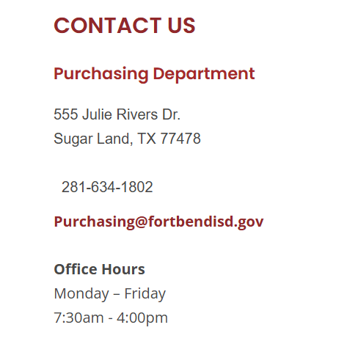

Slide 23
FBISD TRANSITION SERVICES

Slide 24
Debra Wingard
Judy Phillips
FBISD Transition Services

Slide 25
Business To Business Networking
sbep@fortbendisd.gov

Slide 26
What specific programs and services are available for small businesses in my area?
4 Cs - Capital, Contracting, Counseling and Crisis
Capital
7(a) loans | U.S. Small Business Administration
Contracting
Federal Contracting | U.S. Small Business Administration
Counseling
Resource Partners | U.S. Small Business Administration
Crisis
Prepare for emergencies | U.S. Small Business Administration
Disaster assistance | U.S. Small Business Administration

Slide 27
How can I access the Small Business Development Centers (SBDCs) for free counseling and training?
Locations | Texas Gulf Coast Small Business Development Center
    1k SBDC Centers nationwide
    5 Regional Centers in Texas
    1 Regional Center for Houston, Texas Gulf Coast SBDC www.sbdc.uh.edu
13 SBDC Service Centers, I Regional Office

Slide 28
What are the eligibility criteria for the SBA's loan and grant programs?
7(a) loans | U.S. Small Business Administration
    Operate for profit.
    Be in the U.S.
    Meet the SBA's definition of a small business.
    Demonstrate a need for a loan.
    Be creditworthy and reasonably able to repay the loan.
    Have owner equity to invest.
    Not be a type of ineligible business, (Pyramid, Usery, Gender, Adult, non-profit, govt entity)
    Not be able to obtain the desired credit on reasonable terms from non-federal, non-state, and non-local government sources.

Slide 29
Can you provide information on the 8(a) program and how it supports small businesses?
E2G (Empower2Grow)
SBA Empower 2 Grow (Free federal contracting technical assistance, counseling, training, and use of Fedbidspeed)
Empower to Grow | U.S. Small Business Administration
SBA E2G Region VI (Including Houston)
FedMAP SBA E2G Training - FedMap
SBA FedbidSpeed (Make sure that it is free) free platform to search contract opportunities
Your Gateway to Government Contracts | Bidspeed
SBA E2G Eligibility
FedMAP SBA E2G Training - FedMap
Mentorship: Participants receive mentorship from experienced business owners through the mentor-protégé program
SBA Mentor-Protégé program | U.S. Small Business Administration
Capacity Building: The program helps businesses identify areas for capacity building and provides resources to address these gaps
Grow your business | U.S. Small Business Administration
Funding, New locations, Merge and Acquisition, Federal Contracting, Exporting, WOSB, ONAA, VOSB
8(a) Business Development program | U.S. Small Business Administration
The 8(a) Business Development Program supports small businesses owned by socially and economically disadvantaged individuals by providing them with opportunities to secure government contracting.
Key benefits include:
Access to Government Contracts: Participants can win set-aside and sole-source contracts, which are awarded without competition
SBA Federal Contracting
www.sba.gov/contracting
Training and Technical Assistance: The program offers training to help businesses compete effectively in the market
E2G (Empower2Grow)
SBA Empower 2 Grow (Free federal contracting technical assistance, counseling, training, and use of Fedbidspeed)
Empower to Grow | U.S. Small Business Administration

Slide 30
How can I apply for government contracting opportunities through the SBA?
www.Certifications.sba.gov
4 Legacy Programs 8a, HUBZone, WOSB and Veteran Small Business Certification
What resources are available for small businesses recovering from disasters?
Prepare (Risk management)
www.sba.gov/prepare
SBA Office of Disaster Recovery and Resiliency
www.sba.gov/disaster

Slide 31
Can you provide insights on the latest funding opportunities and deadlines for small businesses?
5 Ways to Find an SBA Approved Lender In Houston
SBA Houston Website –Monthly Lender Activity Reports (SBA Houston District Office Website):
This will give you an idea of lenders who are likely to lend in this area as they have in the past.
View a list of Houston local lenders: Houston Lender List | U.S. Small Business Administration (sba.gov)
The Houston Association of Government Guaranteed Lenders (HAGGL) Member Directory (www.haggl.com)
Attend a lending event: Visit our website for upcoming events(Find events | U.S. Small Business Administration (sba.gov))
Work with SBA Resource Partners (Find local resources by clicking here):
They can help prepare business plan & financials, loan package, perfect your pitch, find a specific lender.
Use SBA Lender Match (www.sba.gov/lendematch

